Slide 1
TELECOM CUSTOMER CHURN PREDICTION
Presenter : Rajesh Udayakumar

Slide 2
Business Objective
Retention teams cannot contact everyone
Goal: prioritize customers most likely to churn

Slide 3
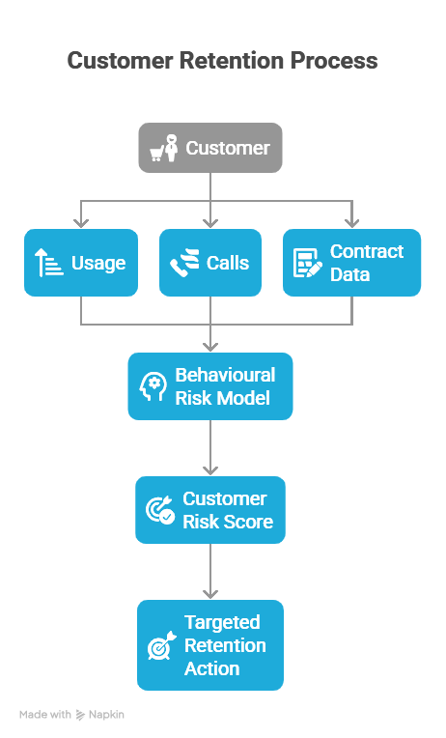
DATA-DRIVEN APPROACH
Unified Data Integration
Behavioural Feature Engineering
Time-Aware Modelling
Strategic Insights for Retention

Slide 4
END TO END WORKFLOW
CUSTOMER DATA
DATA INTEGRATION
USAGE DATA
FEATURE ENGINEERING
(Rolling Feature)
MODEL TABLE
MODEL
RISK SCORING PATTERN
CALL CENTER DATA
CONTRACT DATA

Slide 5

MODEL DESIGN
LightGBM: Fast, Scalable Churn Modelling
Time-Based Train/Test Split (Prevents Data Leakage)

Slide 6
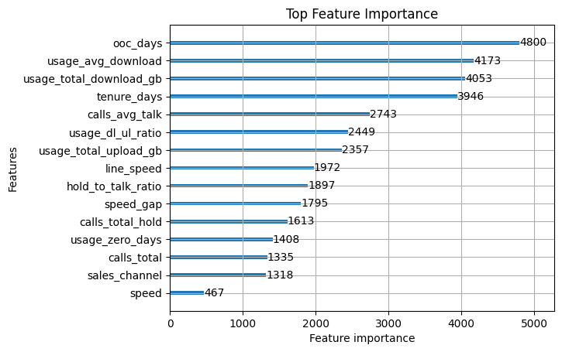
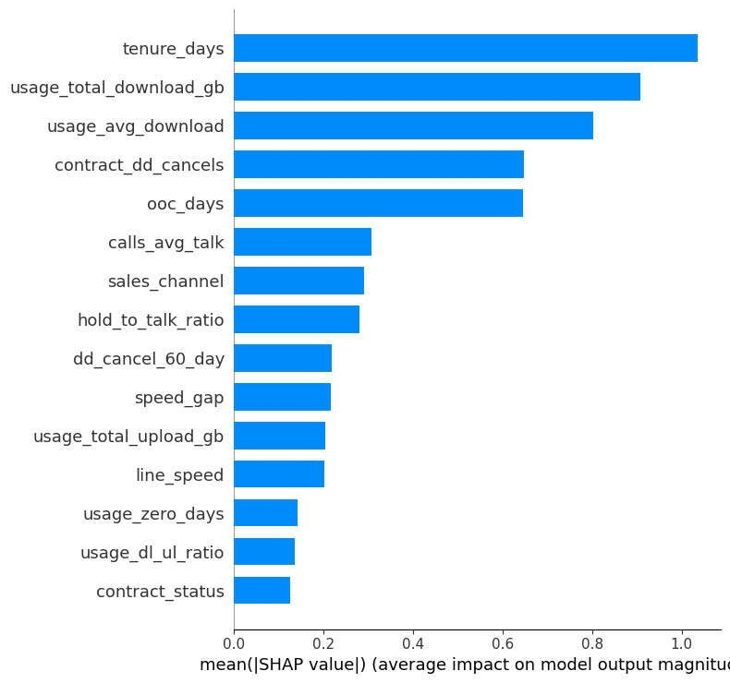
FEATURE IMPORTANCE & SHAP EXPLAINABILITY
SHAP

Slide 7
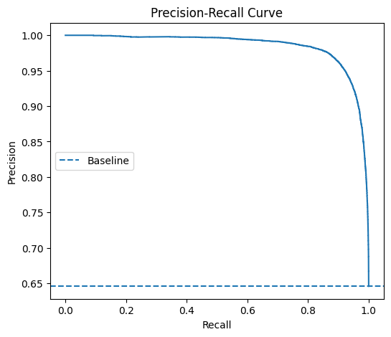
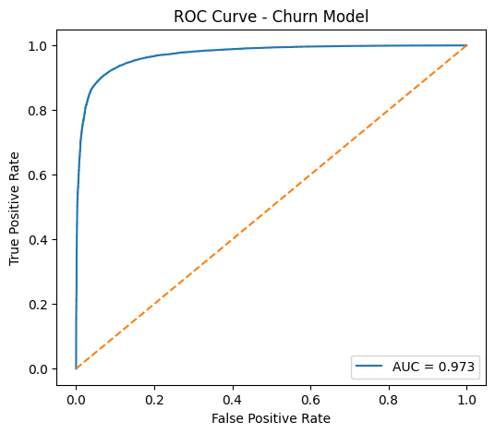
EVALUATION METRICS
Model Accuracy: ~92%
ROC-AUC: 0.97
Recall @ Top 20% = 30.9%
Lift = 1.54x

Slide 8

STRATEGIC NEXT STEPS
Short-Term Churn Forecasting
RAG Integration
CRM Workflow Alignment

